Slide 1

Archiving Tweets with

Slide 2
What is TAGS?
Created in 2010 by Martin Hawksey
Uses Google Sheets to automatically collect and store tweets
Can be used to archive tweets related to events, hashtags, or search terms.

Slide 3
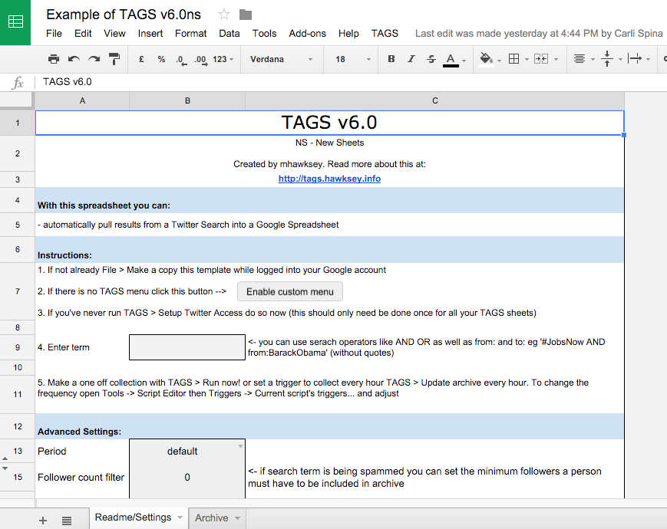
Step 1: Copy Google Sheet

Slide 4
Step 2: Set Up Twitter

Slide 5
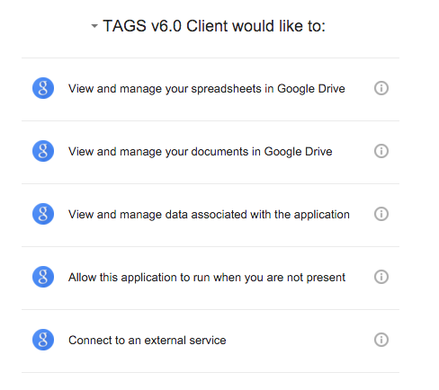
Step 2: Set Up Twitter

Slide 6
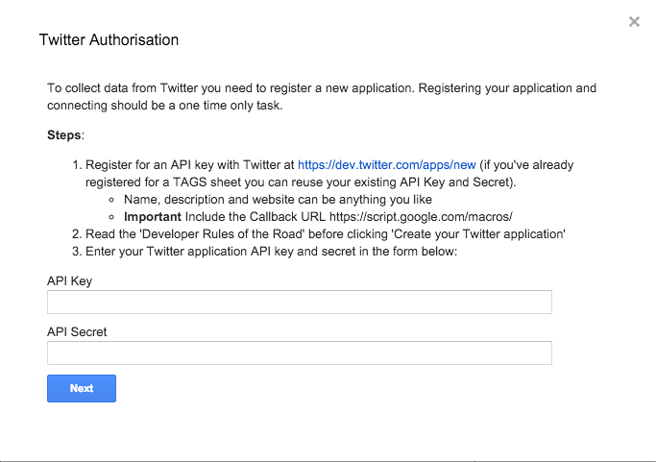
Step 2: Set Up Twitter

Slide 7
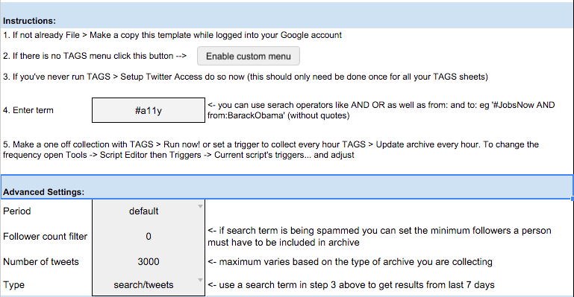
Step 3: Run A Search

Slide 8
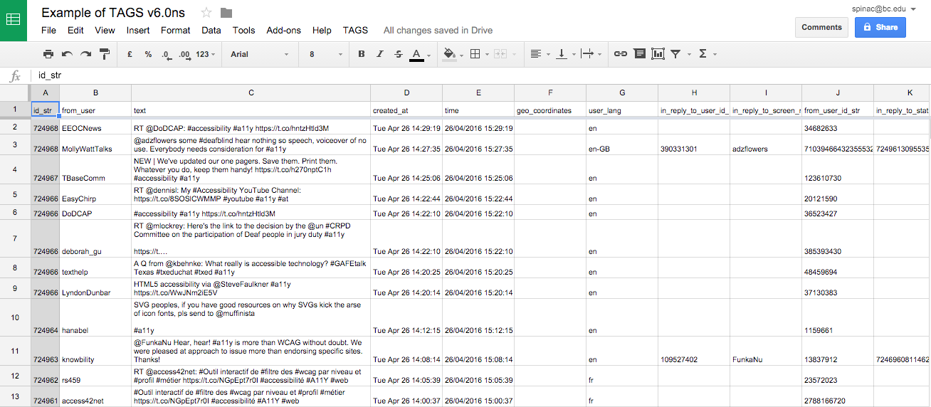
Voilà

Slide 9
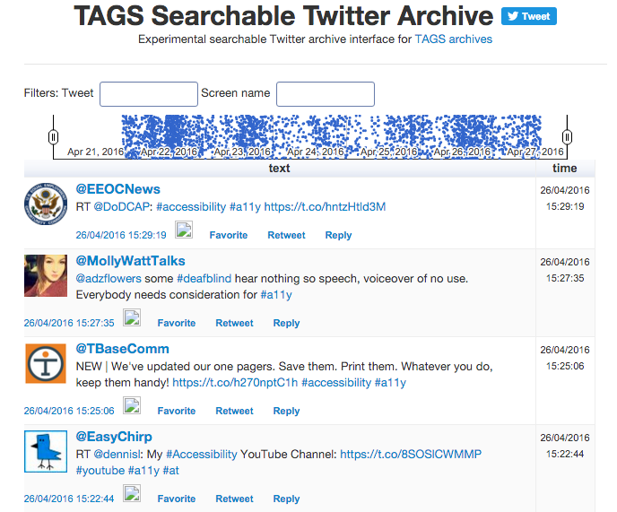

Slide 10
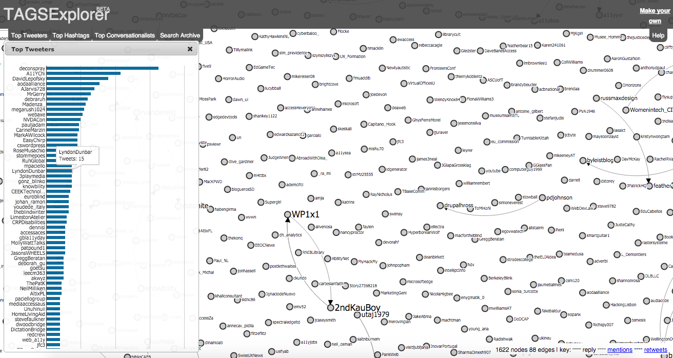

Slide 11
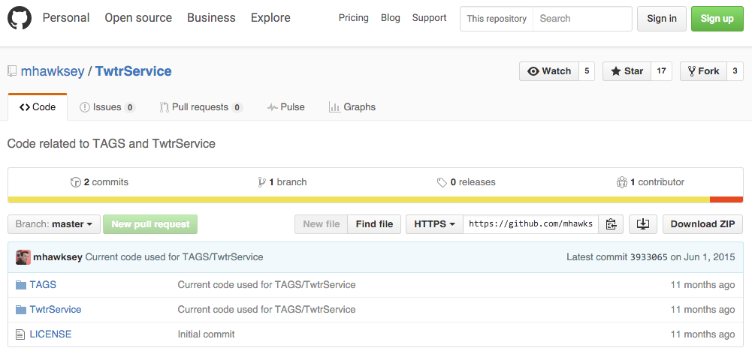
Are you a developer?
TAGS is also available on GitHub

Slide 12
Questions?
Consult the FAQ or Support Forum
Submit a Feature Request
Ask me! You can email me at spinac@bc.edu

